Slide 1

Improving Model Predictions via Stacking and Hyper-Parameters Tuning
Jo-fai (Joe) Chow
Data Scientist
joe@h2o.ai
@matlabulus

Slide 2
About Me
2005 - 2015
Water Engineer
Consultant for Utilities
EngD Research
2015 - Present
Data Scientist
Virgin Media
Domino Data Lab
H2O.ai

Slide 3
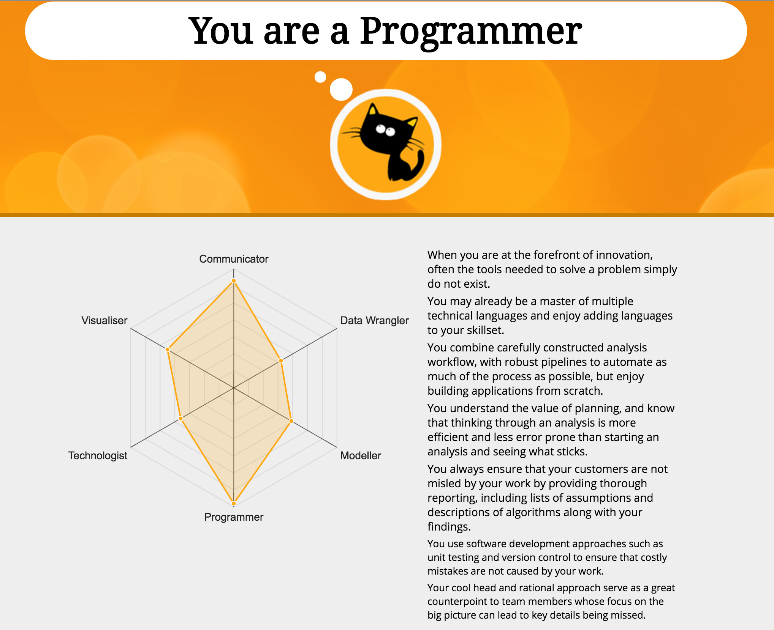
Mango Data Science Radar

Slide 4
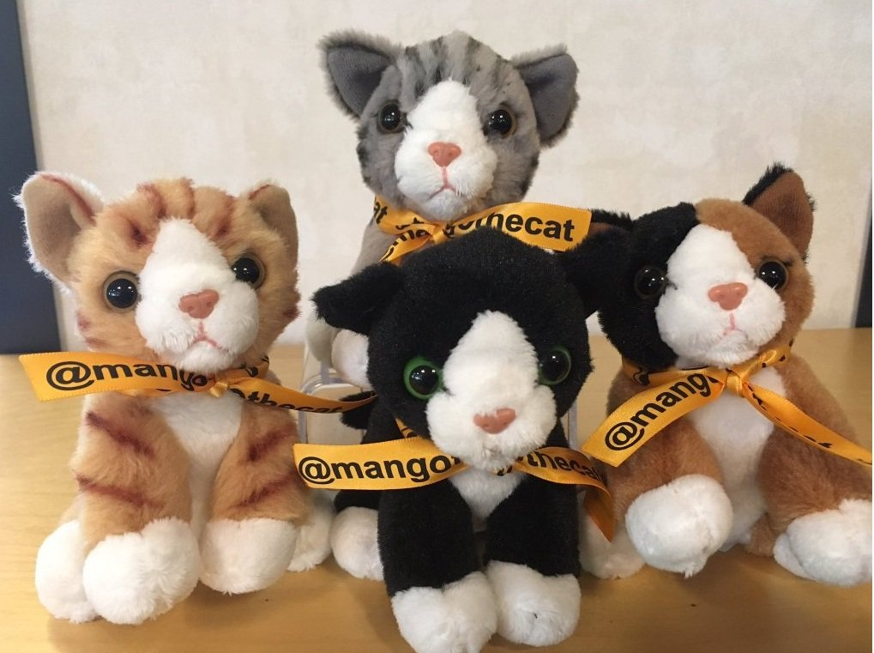
About This Talk
Predictive modelling
Kaggle as an example
Improve predictions with simple tricks
Use data science for social good 👍

Slide 5
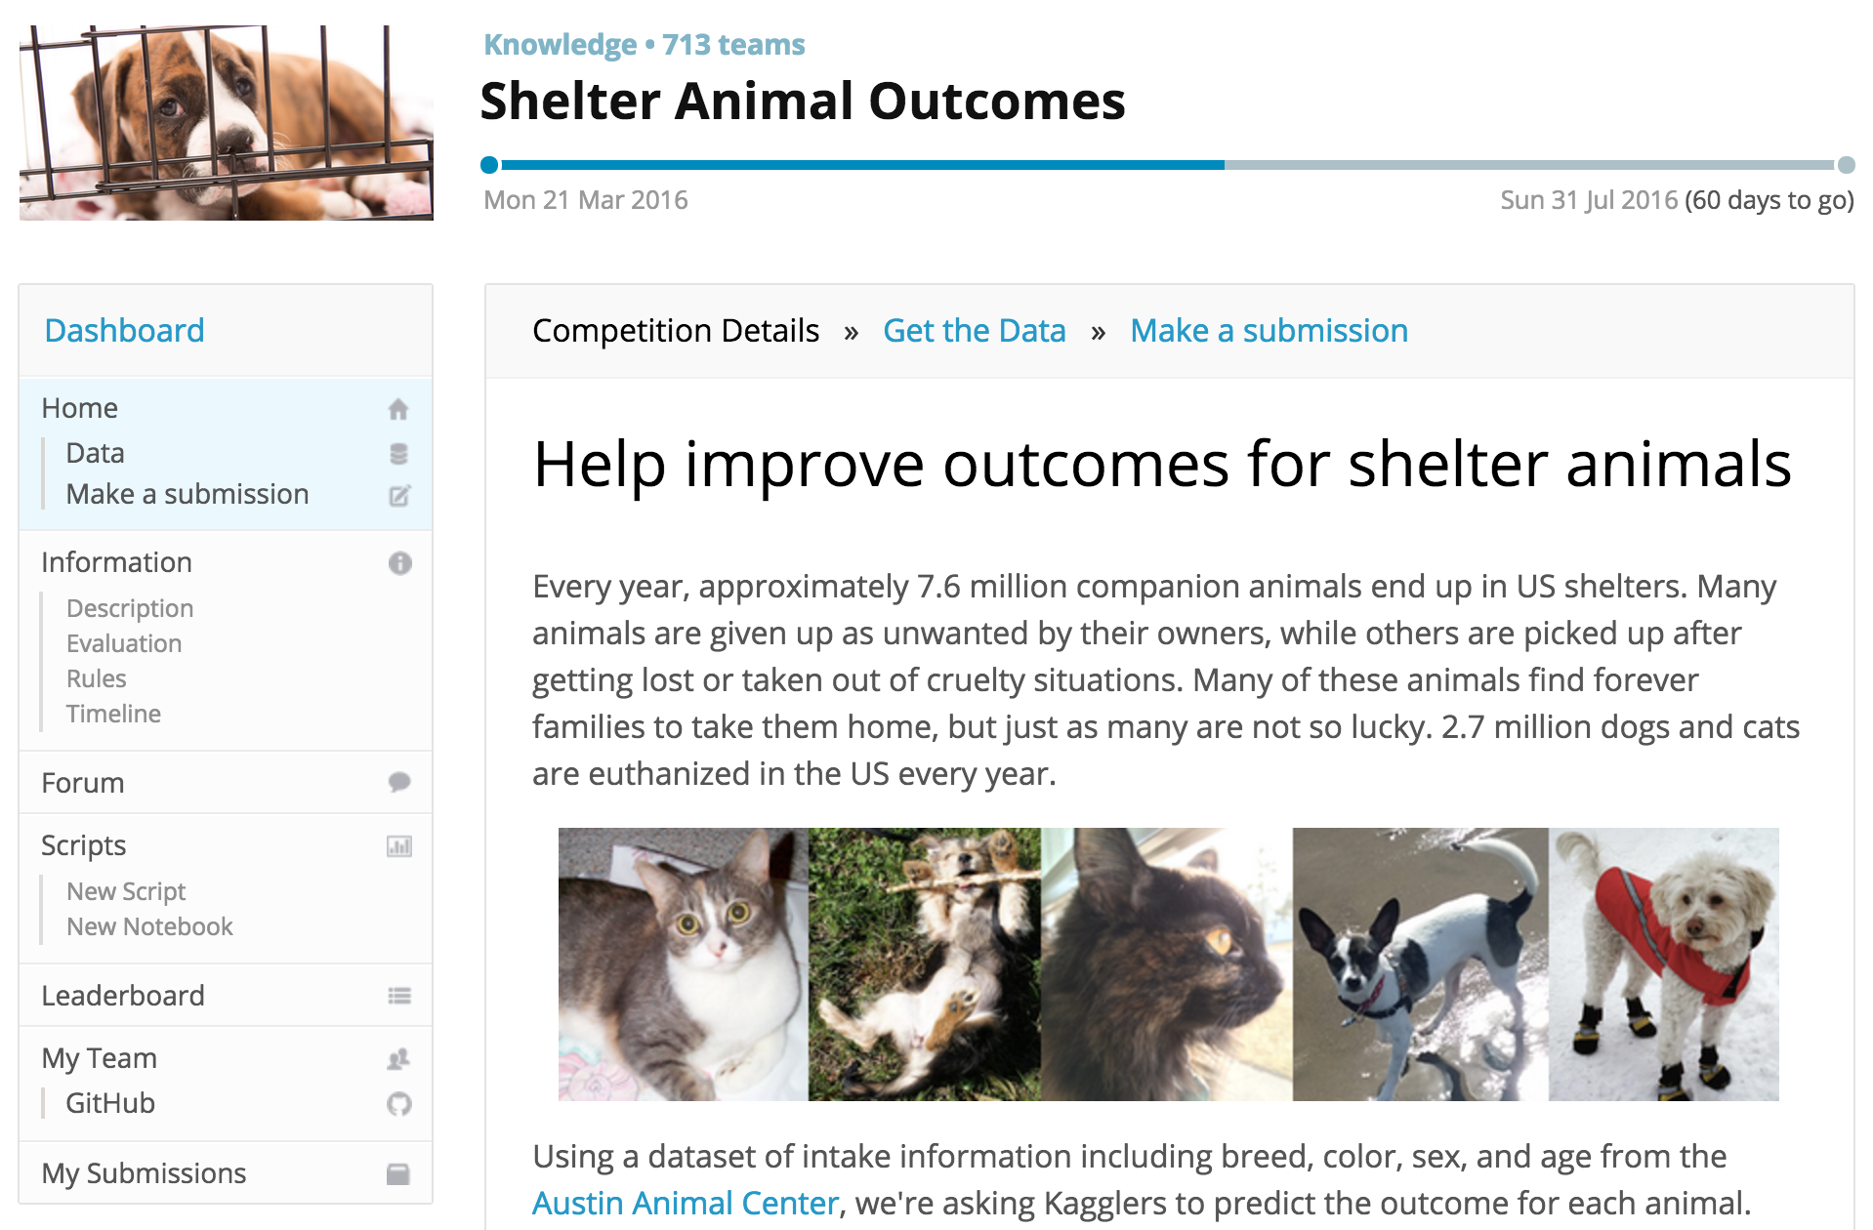
About Kaggle
World’s biggest predictive modelling competition platform
560k members
Competition types:
Featured (prize)
Recruitment
Playground
101
Notes:
All slides and code available online – sit back and relax, remember you’re here today for a good cause, care about shelter animals

Slide 6
Predicting Shelter Animal Outcomes
X: Predictors
Name
Gender
Type (🐱 or 🐶)
Date & Time
Age
Breed
Colour
Y: Outcomes (5 types)
Adoption
Died
Euthanasia
Return to Owner
Transfer
Data
Training (27k samples)
Test (11k)

Slide 7
Basic Feature Engineering
X | Raw (Before) | Reformatted (After)
Name | Elsa, Steve, Lassie | [name_len]: 4, 5, 6
Date & Time | 2014-02-12 18:22:00 | [year]: 2014 [month]: 2 [weekday]: 4 [hour]: 18
Age | 1 year, 3 weeks, 2 days | [age_day]: 365, 21, 2
Breed | German Shepherd, Pit Bull Mix | [is_mix]: 0, 1
Colour | Brown Brindle/White | [simple_colour]: brown

Slide 8
Common Machine Learning Techniques
Ensembles
Bagging/boosting of decision trees
Reduces variance and increase accuracy
Popular R Packages (used in next example)
“randomForest”
“xgboost”
There are a lot more machine learning packages in R:
“caret”, “caretEnsemble”
“h2o”, “h2oEnsemble”
“mlr”

Slide 9
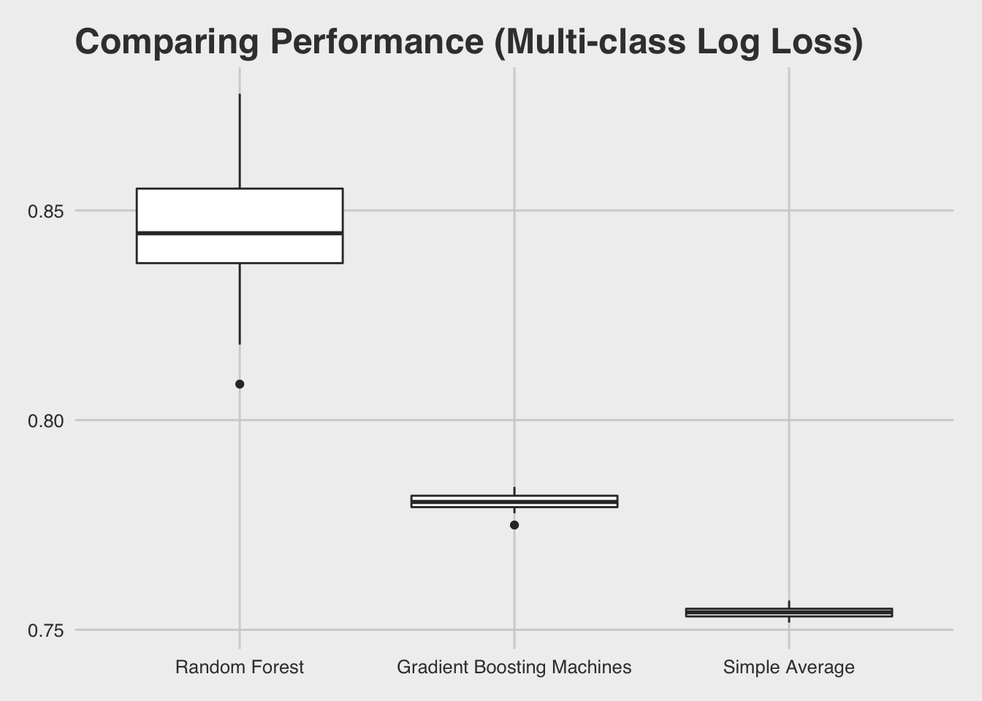
Simple Trick – Model Averaging
Stratified sampling
80% for training
20% for validation
Evaluation metric
Multi-class Log Loss
Lower the better
0 = Perfect
50 runs
different random seed

Slide 10
More Advanced Methods
Model Stacking
Uses a second-level metalearner to learn the optimal combination of base learners
R Packages:
“SuperLearner”
“subsemble”
“h2oEnsemble”
“caretEnsemble”
Hyper-parameters Tuning
Improves the performance of individual machine learning algorithms
Grid search
Full / Random
R Packages:
“caret”
“h2o”
For more info, see
https://github.com/h2oai/h2o-meetups/tree/master/2016_05_20_MLconf_Seattle_Scalable_Ensembles
https://github.com/h2oai/h2o-3/blob/master/h2o-docs/src/product/tutorials/gbm/gbmTuning.Rmd

Slide 11
Trade-Off of Advanced Methods
Strength
Model tuning + stacking won nearly all Kaggle competitions.
Multi-algorithm ensemble may better approximate the true predictive function than any single algorithm.
Weakness
Increased training and prediction times.
Increased model complexity.
Requires large machines or clusters for big data.

Slide 12
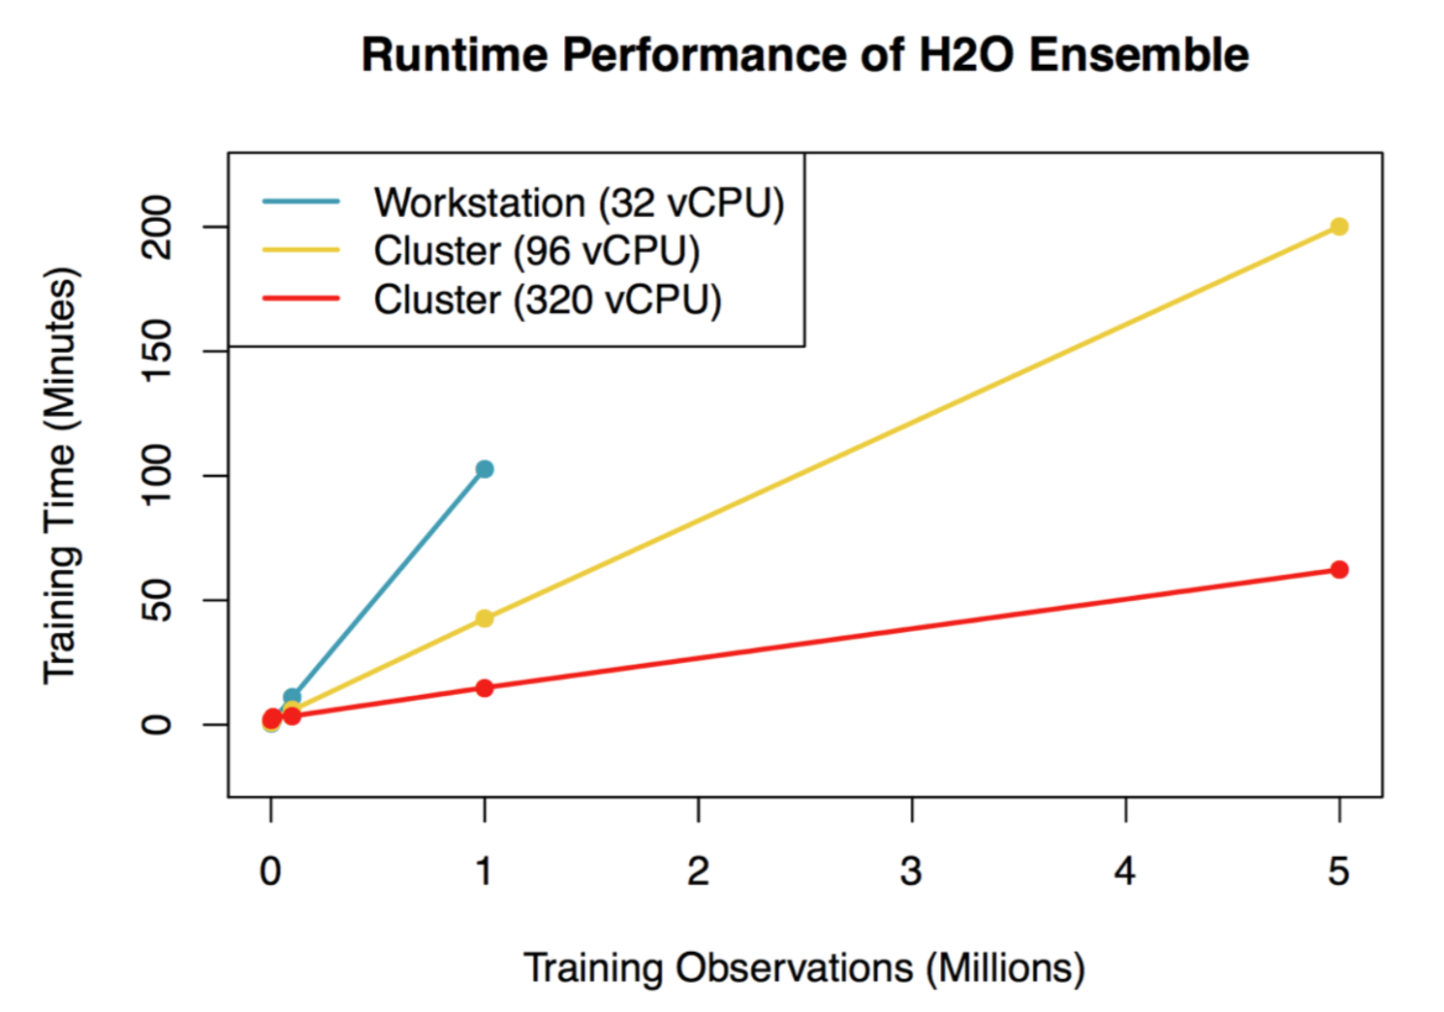
R + H2O = Scalable Machine Learning
H2O is an open-source, distributed machine learning library written in Java with APIs in R, Python and more.
”h2oEnsemble” is the scalable implementation of the Super Learner algorithm for H2O.

Slide 13
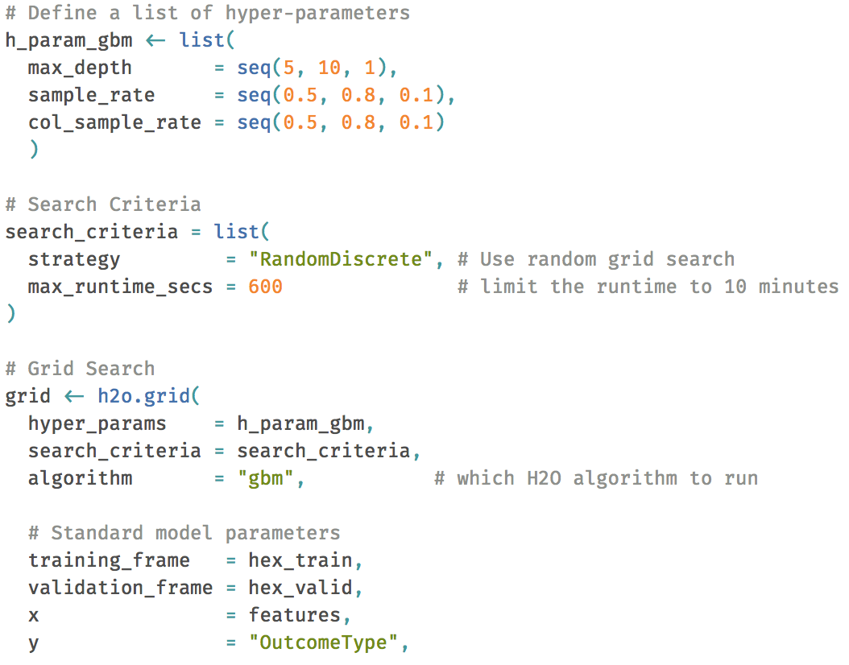
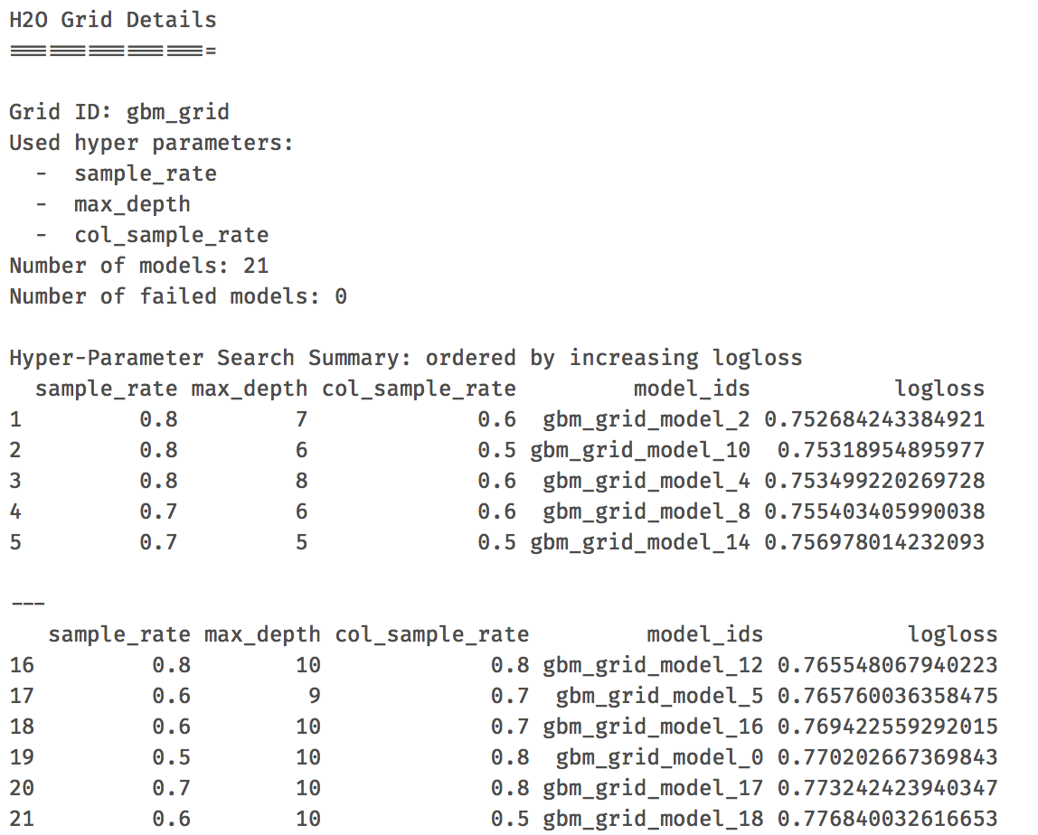
H2O Random Grid Search Example
Define search range and criteria
Best models

Slide 14
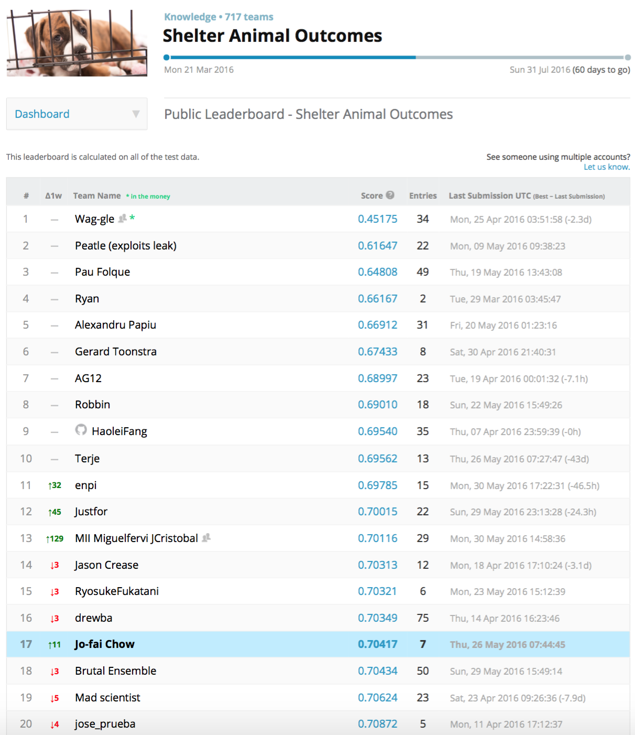
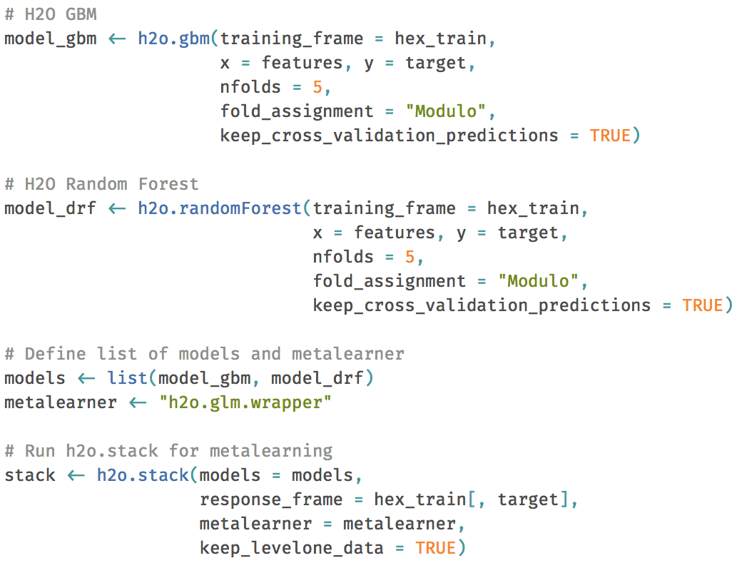
H2O Model Stacking Example
Using h2o.stack(…) to combine multiple models
Getting reasonable results
17 out of 717 teams (≈ top 2%)

Slide 15
Conclusions
Many R packages for predictive modelling.
Use hyper-parameters tuning to improve individual models.
Use model averaging / stacking to improve predictions.
Trade-off between model performance and computational costs.
Use R + H2O for scalable machine learning.
H2O random grid search and stacking.
Use data science for social good 👍

Slide 16
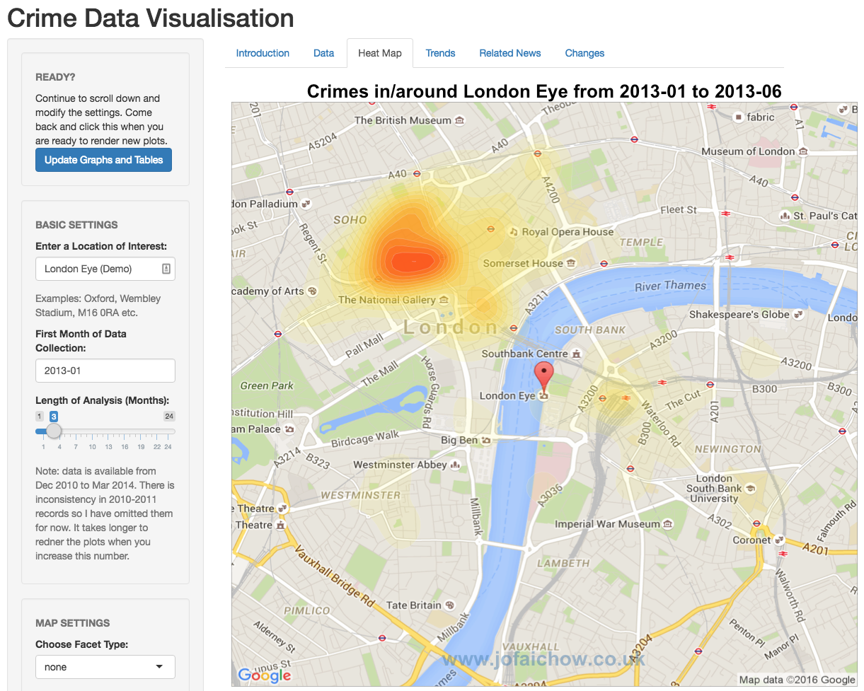
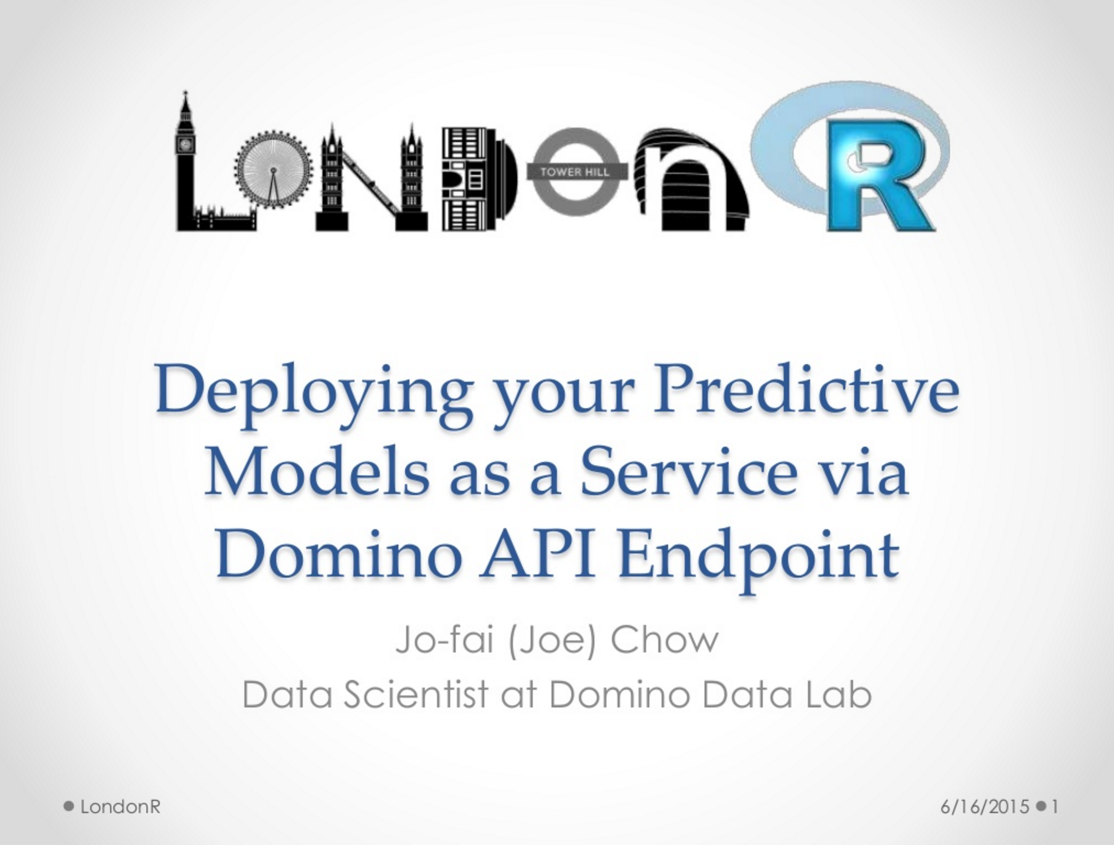
Big Thank You!
Mango Solutions
RStudio
Domino Data Lab
H2O
Erin LeDell
Raymond Peck
Arno Candel
1st LondonR Talk
Crime Map Shiny App
bit.ly/londonr_crimemap
2nd LondonR Talk
Domino API Endpoint
bit.ly/1cYbZbF

Slide 17
Any Questions?
Contact
joe@h2o.ai
@matlabulous
github.com/woobe
Slides & Code
github.com/h2oai/h2o-meetups
H2O in London
Meetups / Office (soon)
www.h2o.ai/careers
More H2O at Strata tomorrow
Innards of H2O (11:15)
Intro to Generalised Low-Rank Models (14:05)

Slide 18
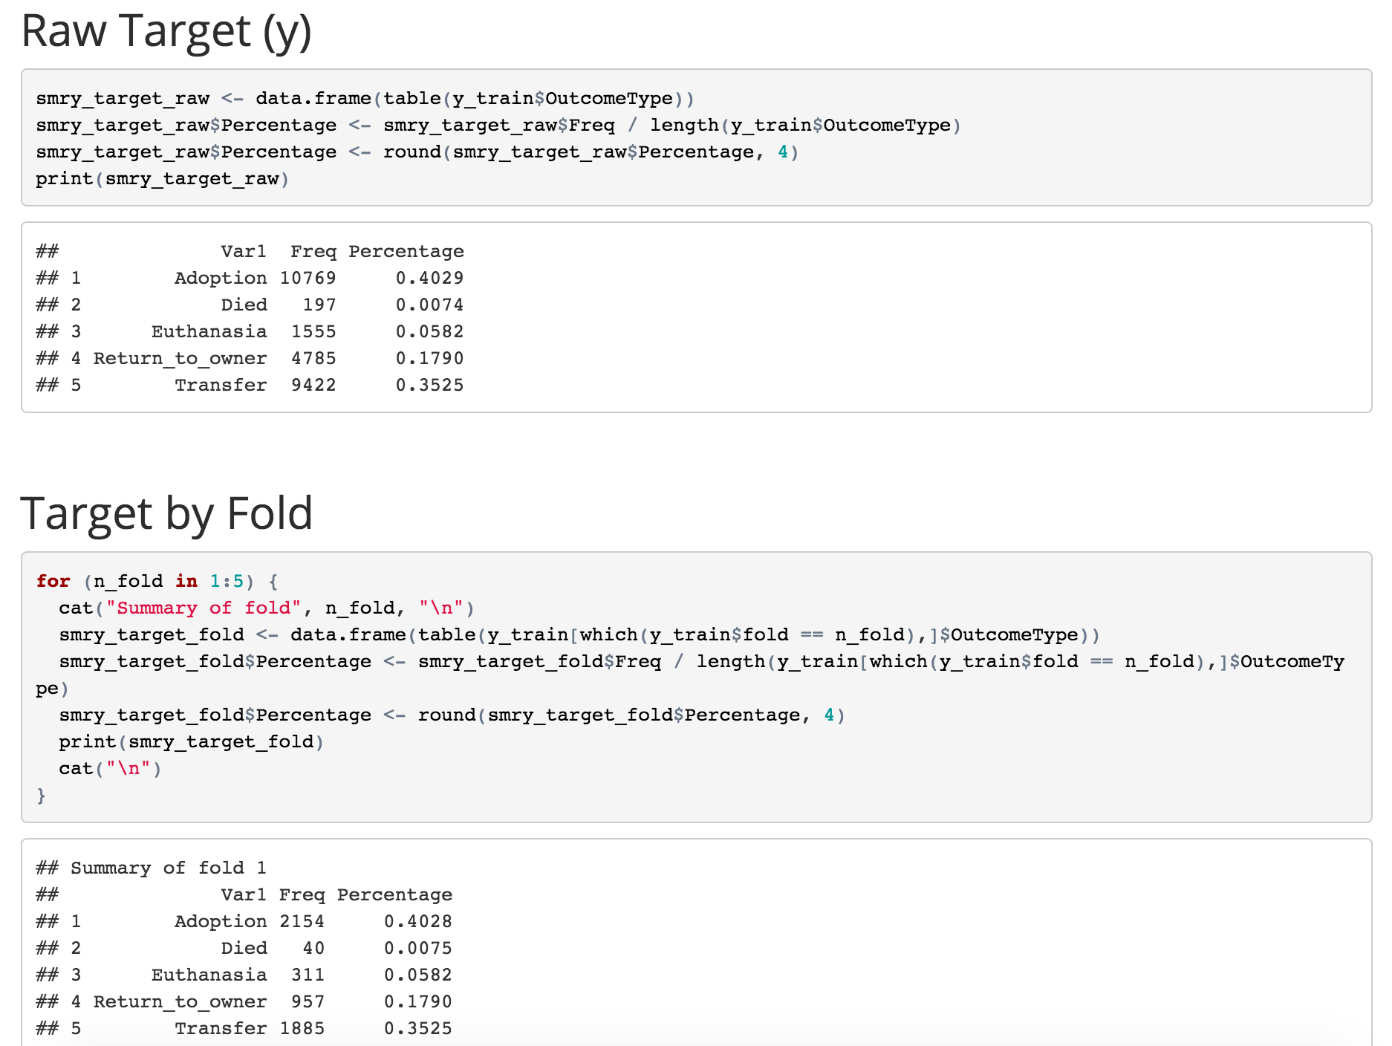
Extra Slide (Stratified Sampling)

